Slide 1
2013 - MAY
TRINITY COATING SYSTEMS Ltd.
105/106, Infantry Court, 130, Infantry Road,
Bangalore - 560 001, India
Phone : 22863 155/156 Fax : 080 22863157
E-mail : info@trinitycoating.com
TRINITY COATING SYSTEMS Ltd.

Slide 2
Stockholder
2013 - MAY
(MAR .2013 DATA )
TRINITY INDUSTRIAL CORP (JAPAN) 100%
TRINITY COATING SYSTEMS Ltd.

Slide 3
Major Customer
2013 - MAY
TOYOTA KIRLOSKAR MOTOR PVT. LTD.
- Delivered Equipment System List
#1 Line PT/ED System
#1 Line Spray Booth System
#1 Line Application System
#1 Line Paint Circulation System
#1 Flame Line PT/ED System (Small Parts)
#1 Bumper Paint System
#2 Line PT/ED System
#2 Line Application System
#2 Line Paint Cartridge System (Primer & Top Coat)
#2 Line Bumper Paint System
#2 Line Small Parts PT/ED (On going)
#2 Line Small Parts Oven (On going)
#2 Topcoat Booth Shop
#2 Bumper B Line
TRINITY COATING SYSTEMS Ltd.

Slide 4
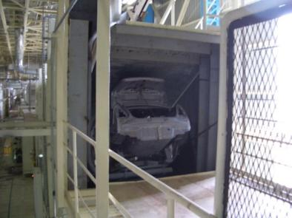
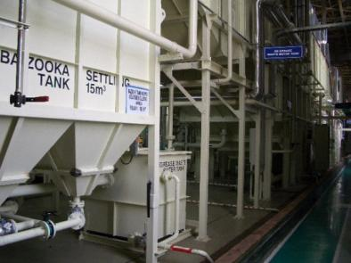
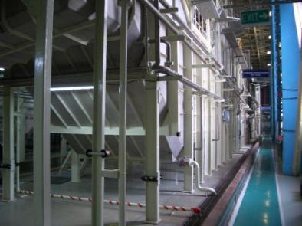
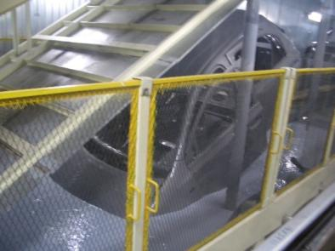
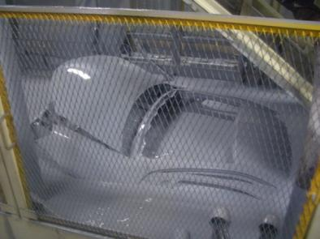
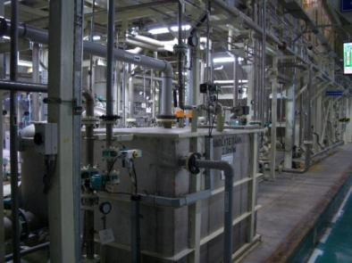
Products
2013 - MAY
Paint Plants
- Pre Treatment System
Entrance
Bazooka Wash
Pre Wash Tank
- E-Coat System
Entrance of ED Tank
Exit of ED Tank
E-cat Paint Circulation
TRINITY COATING SYSTEMS Ltd.

Slide 5
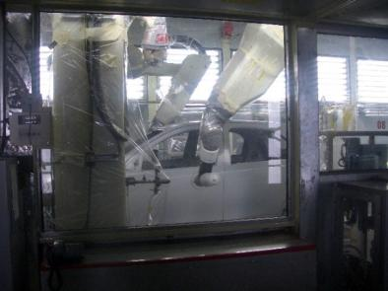
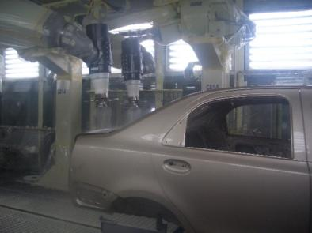
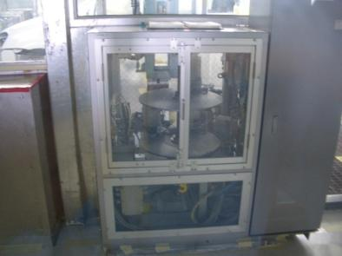
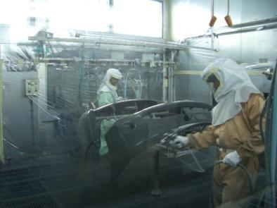
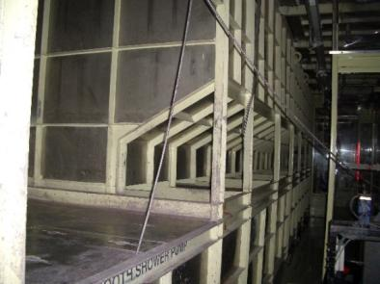
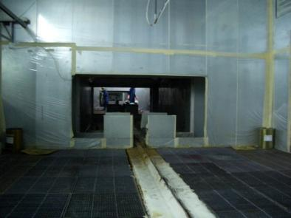
Products
2013 - MAY
Paint Plants
- Painting Equipment System
Primer Paint Robot
Top Coat Paint Robot
Paint Cartridge System
- Bumper Paint Booth
Primer Paint Spray
Booth Under Section
Clear Spray Zone
TRINITY COATING SYSTEMS Ltd.

Slide 6
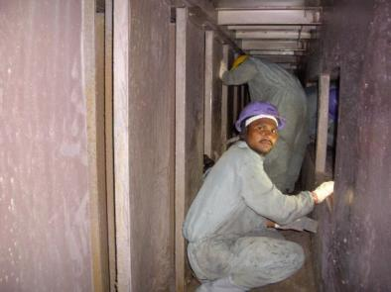
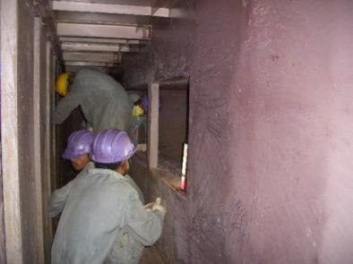
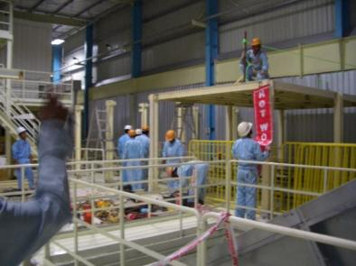
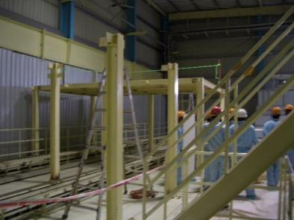
2013 - MAY
Cleaning & Small Construction
Cleaning Service
- Booth Under Section
Small Construction
- Deck Installation
TRINITY COATING SYSTEMS LTD.

Slide 7
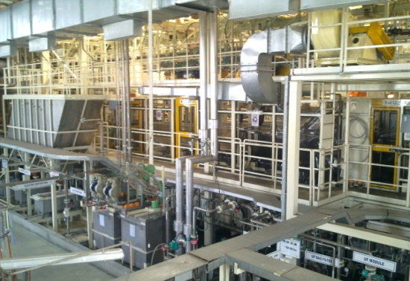
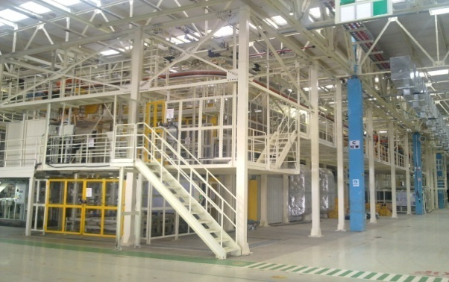
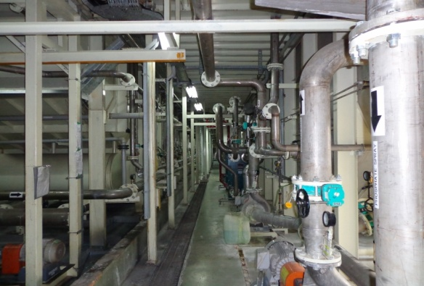
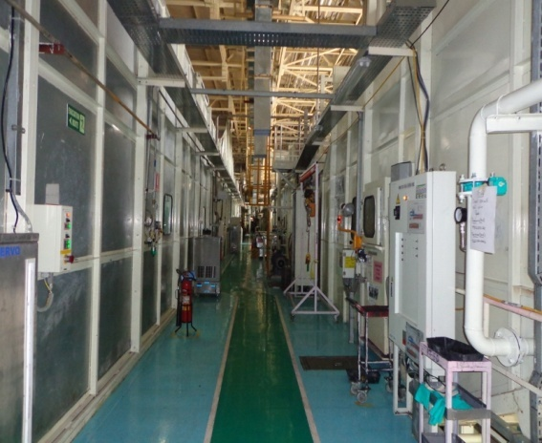
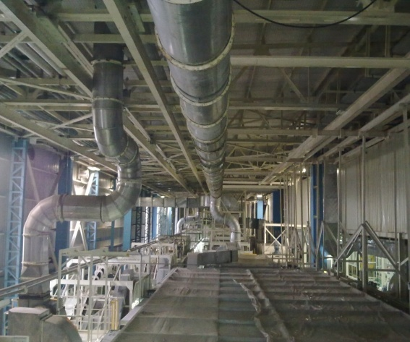
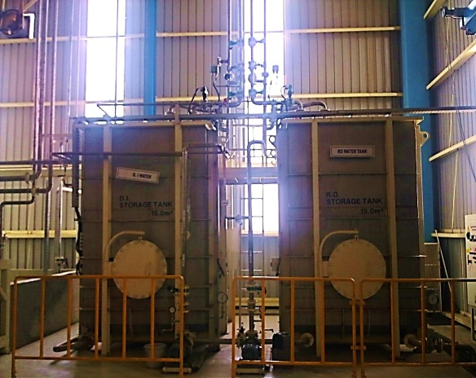
On Going Project (May 2013)
TURNKEY PROJECTS OF CAR BODY AND PARTS PTED AND OVEN SYSTEM
- Pre Treatment & E-Coat Systems
PIPING
DUCTING
BOOTHS AND ENCLOSURES
STORAGE TANKS AND AUTOMATION
TRINITY COATING SYSTEMS Ltd.

